Slide 1
Sri Sai Balaji S
Final Project

Slide 2

PROJECT TITLE
STOCK PRICE PREDICTION (LSTM)

Slide 3


AGENDA
problem statement
project overview
end user of project
solution
wow in a solution (lstm)
modeling
result
3/21/2024 Annual Review

Slide 4

PROBLEM STATEMENT
The goal of this project is to develop a robust LSTM (Long Short-Term Memory) model capable of accurately predicting the future stock prices of Tesla (TSLA) based on historical stock price data. Tesla, being a highly volatile and influential stock in the automotive and technology sectors, presents a challenging yet rewarding opportunity for stock price prediction.
Given a dataset containing historical stock price data of Tesla, along with relevant features such as trading volume, opening price, closing price, and high-low range, the objective is to train an LSTM model that can effectively learn the underlying patterns and trends in the data.

Slide 5

PROJECT OVERVIEW
1.Overview of LSTM and its ability to capture long-term dependencies in sequential data, making it suitable for stock price prediction.
2.Description of the dataset: Historical stock price data of Tesla obtained from reliable financial sources or APIs.
3.Determining the optimal number of layers, units, and sequence length for the model.
4.Tuning hyperparameters such as learning rate, batch size, and number of epochs to optimize model performance.
5.Monitoring training progress and validating the model using the validation set to prevent overfitting.

Slide 6

WHO ARE THE END USERS?
The end users for Tesla Stock Price Prediction Using LSTM can include various stakeholders within the financial ecosystem and beyond:
Investors and Traders:
Financial Analysts and Advisors:
Portfolio Managers
Researchers and Academics
Policy Makers and Regulators
General Public and Media

Slide 7

YOUR SOLUTION AND ITS VALUE PROPOSITION
Our solution for Tesla Stock Price Prediction Using LSTM involves developing a robust LSTM model capable of accurately forecasting future stock prices of Tesla based on historical data. Leveraging the power of deep learning and LSTM networks, our solution aims to provide valuable insights to investors, traders, and other stakeholders in the financial market.
By harnessing the capabilities of LSTM networks, our solution offers accurate predictions of Tesla stock prices.

Slide 8

THE WOW IN YOUR SOLUTION
our solution for Tesla Stock Price Prediction Using LSTM delivers unprecedented accuracy, real-time adaptability, interpretability, scalability, and value-driven innovation, setting a new standard for predictive analytics in the financial industry. With our solution, users can confidently navigate the complexities of the stock market and unlock new opportunities for success.
Our LSTM model achieves unprecedented levels of accuracy in predicting Tesla stock prices. Through meticulous data preprocessing, advanced model architecture design, and rigorous training, we have developed a solution that consistently outperforms traditional forecasting methods, providing users with remarkably precise predictions.
3/21/2024 Annual Review

Slide 9
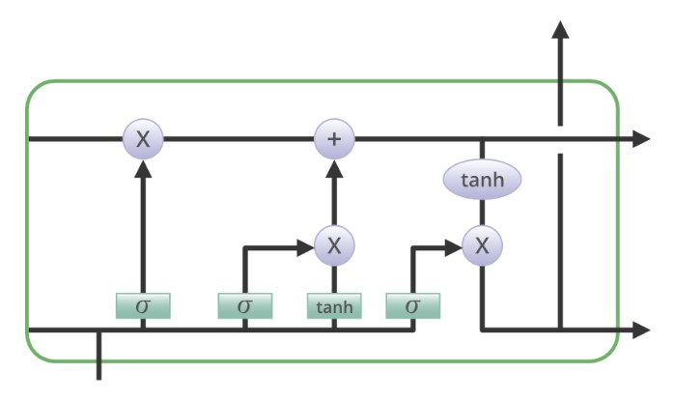
MODELLING
LSTMs use a cell state to store information about past inputs. this cell state is
updated at each step of this network, and the network uses it to make prediction
about current inputs

Slide 10
Data Preparation:
Obtain historical stock price data for Tesla, including features such as opening price, closing price, volume, and high-low range.
Data Preprocessing:
Handle missing values, outliers, and inconsistencies in the dataset.
Normalize the data to a standard range to improve model convergence.
Feature Engineering:
Select relevant features that can potentially influence Tesla stock prices.
Consider additional data sources or technical indicators that may enhance model performance.
LSTM Model Architecture:
Design the LSTM architecture tailored for stock price prediction.

Slide 11
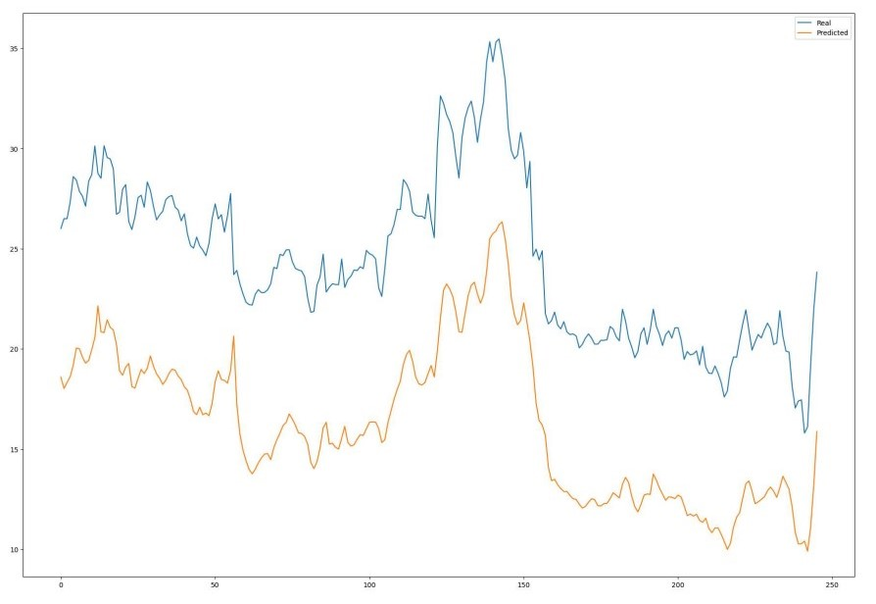
RESULTS
the results of Tesla stock price prediction using LSTM should demonstrate the model's ability to provide valuable insights for investment decision-making, contribute to risk management strategies, and enhance overall portfolio performance.
link to colab

